Slide 1

Chapter 1 The Basics
How to Use MATLAB/SIMULINK
09 September 2026
By Nathaniel Tyler

Slide 2


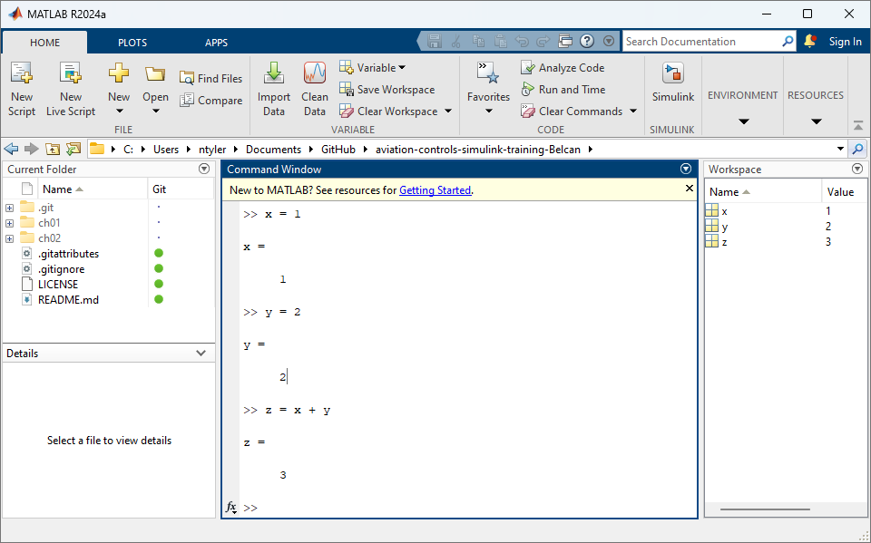
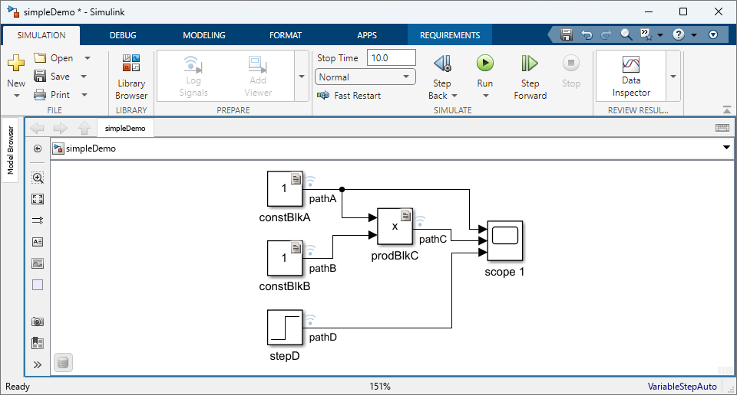
What is MATLAB and Simulink?
MATLAB and Simulink provide a unified environment for model-based development, simulation, and verification of complex engineering systems.
What is MATLAB and Simulink?
MATLAB
Simulink
Numerical computing, analysis, and algorithm development.
Graphical modeling and simulation of dynamic systems.

Slide 3
What are some useful commands for MATLAB and Simulink?
What are some useful commands for MATLAB and Simulink?
MATLAB
Simulink
What are some useful commands?
What are some useful shortcuts?
Clear workspace clear
Clean window clc
Cancel Action CTRL + C
Save CTRL + S
Cancel Action CTRL + C
Compile CTRL + D
Build CTRL + B
Run Sim CTRL + T

Slide 4
Success looks like knowing how to …
What does success look like?
Open MATLAB & SIMULINK
Create a new Simulink Model
Use blocks
Run a simulation
Use Data inspector
Use Model Explorer
Use Requirements editor
Slide 5 Shows a final product of the Example we will be walking thru.

Slide 5
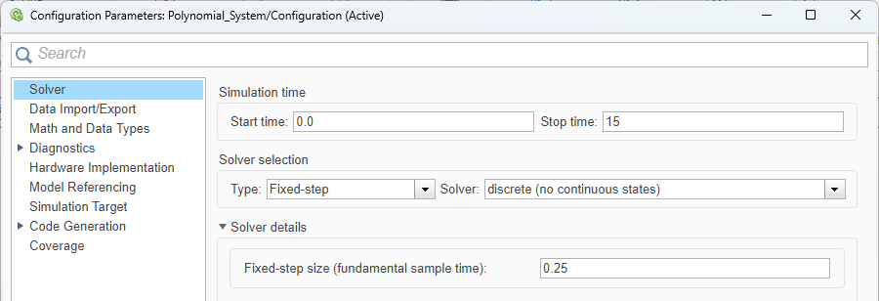
polynomial_System.slx (Model Settings)
Note: How you Models Settings should be setup.
Final Setup

Slide 6
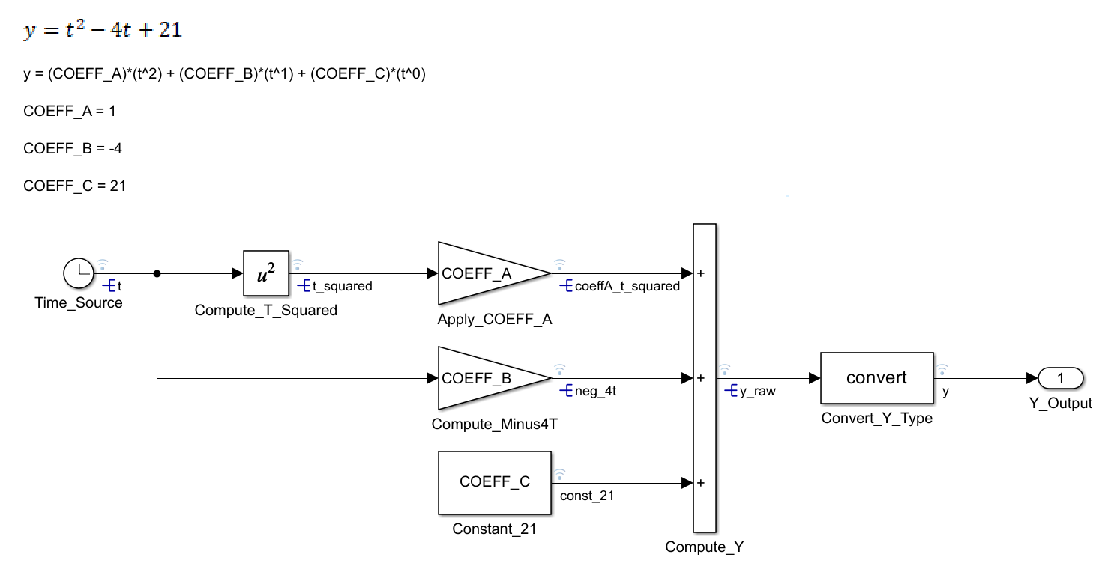
polynomial_System.slx (Model File)
Note: How your Model Should look when Finished
Final Setup

Slide 7
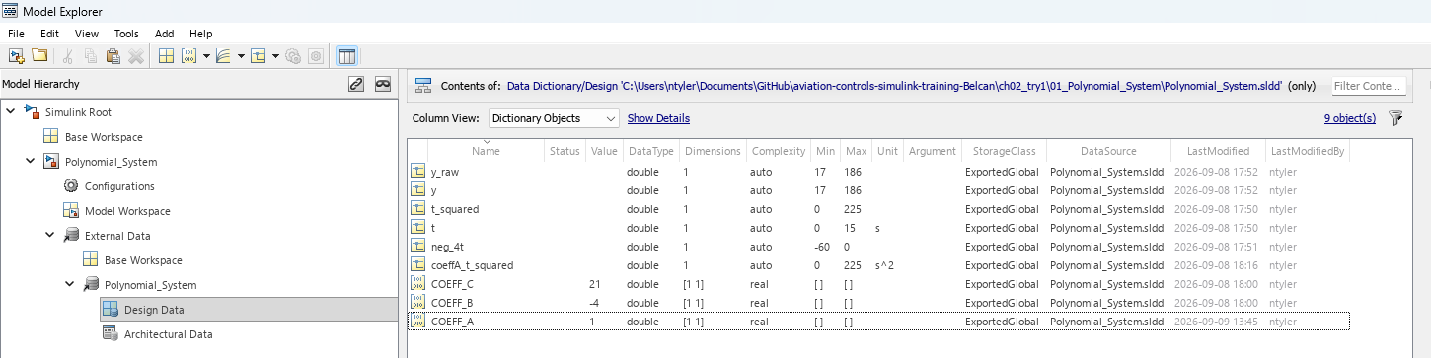
polynomial_System.sldd (Data Dictionary)
Note: Contains Signals & Parameters
Final Setup

Slide 8
How to Download the Git Repo

Slide 9
Git Hub Training Repo
How to Download the Git Repo
Git Hub Webpage
  ntylerbelcan/aviation-controls-simulink-training-Belcan
Ensure you are in a folder called “GitHub” before your run either of the following commands:
  In Git Bash / Terminal you can run
    git clone https://github.com/ntylerbelcan/aviation-controls-simulink-training-Belcan.git
  OR
  In MATLAB
    You can clone directly from the MATLAB command window:MATLAB
    system('git clone https://github.com/ntylerbelcan/aviation-controls-simulink-training-Belcan.git')

Slide 10
How to Open MATLAB & SIMULINK

Slide 11
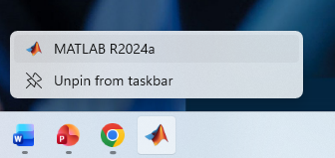
Open MATLAB
How to Open MATLAB & SIMULINK

Slide 12
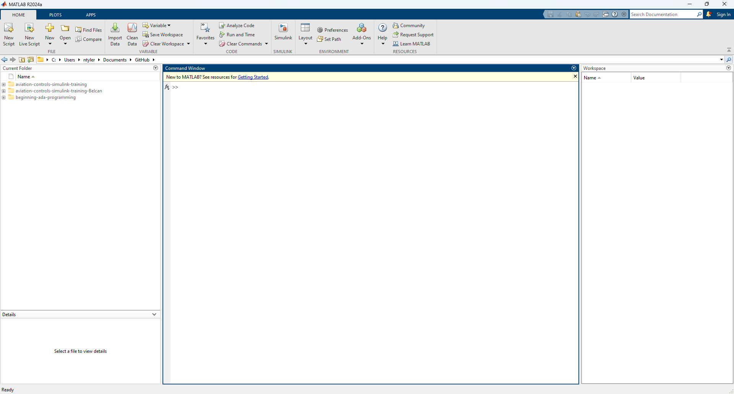
Review the MATLAB Window Layout
How to Open MATLAB & SIMULINK

Slide 13
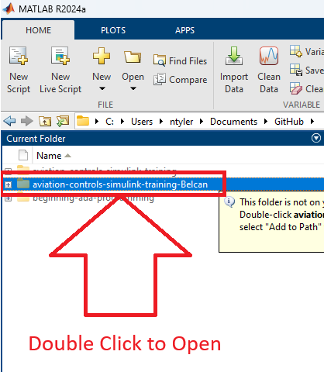
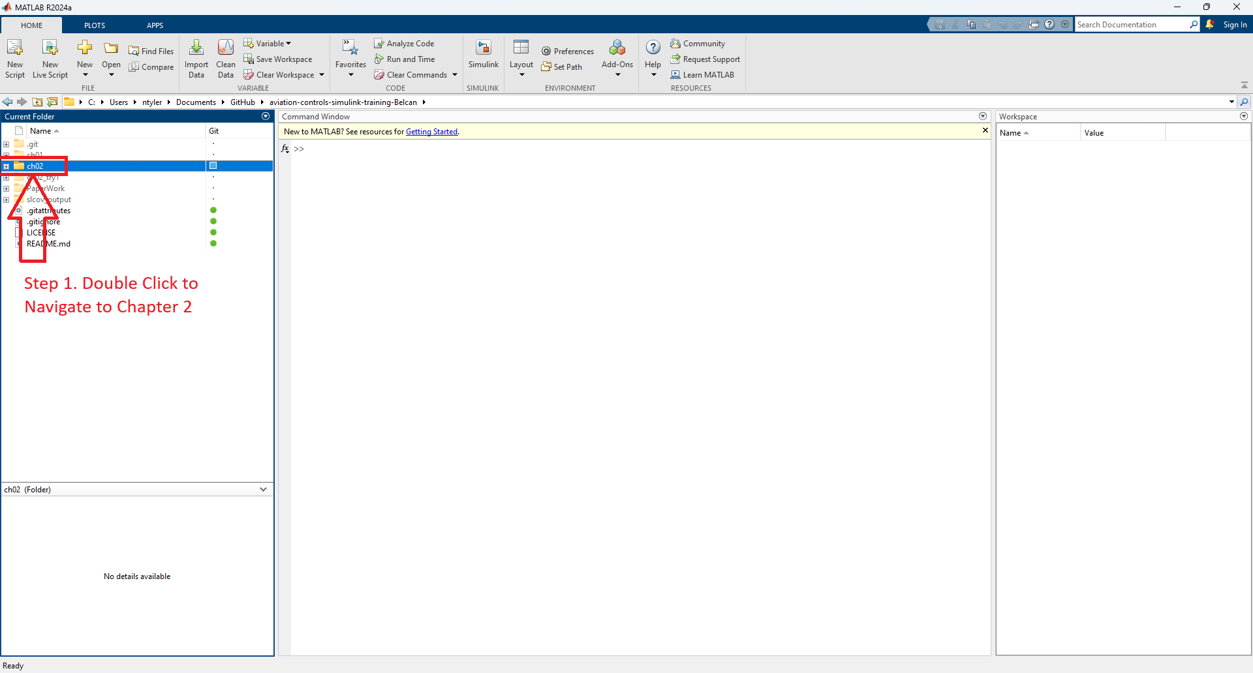
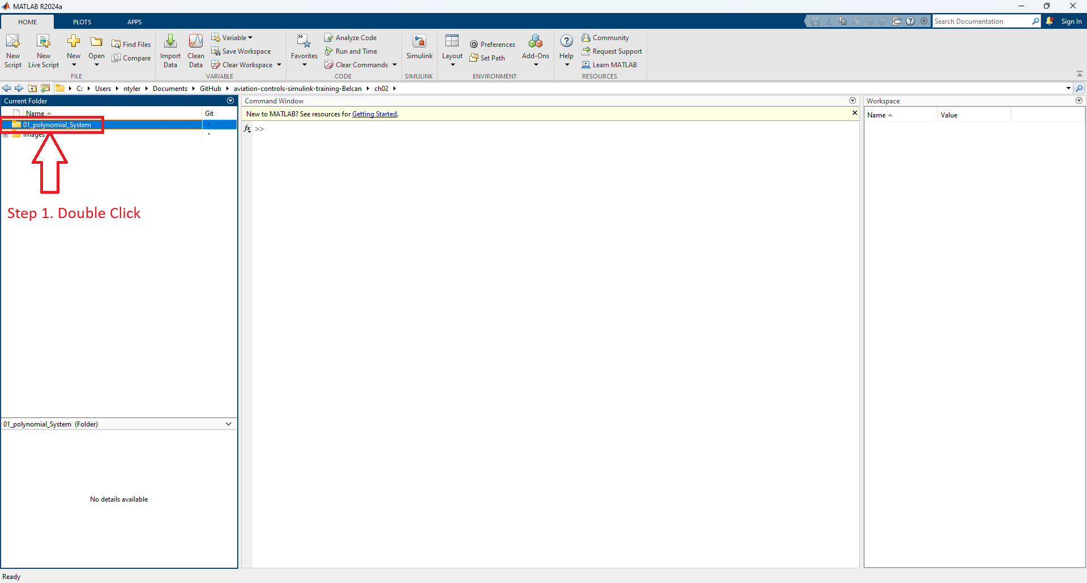
Navigate to training folder (Summary)
How to Open MATLAB & SIMULINK
Step 1. Navigate to training folder
Step 2. Navigate to Chapter 2 folder
Step 2. Navigate to sub folder “01_polynomial_System”

Slide 14
How to Add To Project

Slide 15
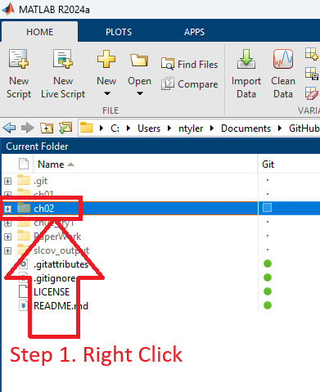
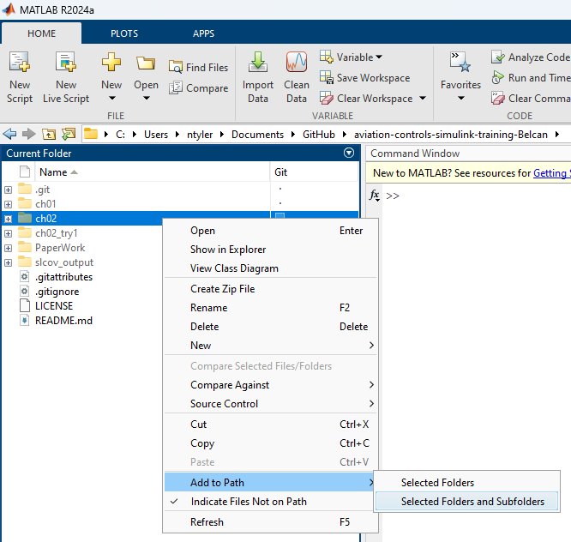

Add “ch02” Folder and Sub Folders to Project
How to Add To Project
Step 1. Right Click Folder
Step 2. Click “Add Selected Folders and Subfolders”
Step 3. Observe Folder has been added to path

Slide 16
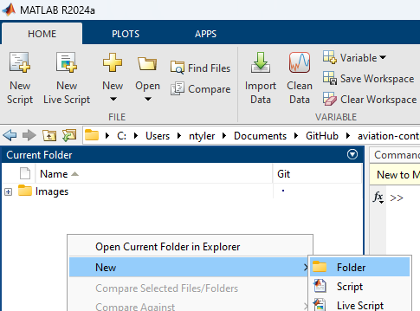
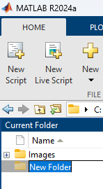
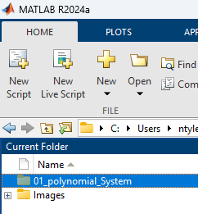
Create New Folder “01_polynomial_System”
How to Add To Project
Step 1. Double Click ch02 Folder
Step 2. Right Click on Empty Space and Click “Folder”
Step 3.
Rename Folder
Step 4. Rename Folder to
01_polynomial_System

Slide 17

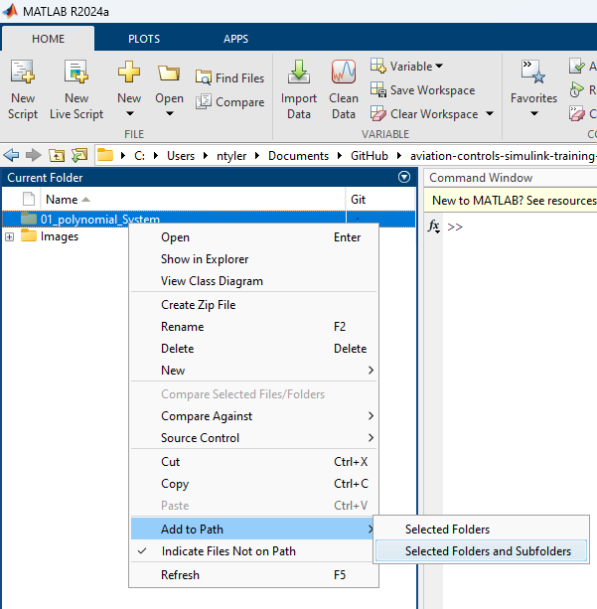

Add “01_polynomial_System” Folder and Sub Folders to Project
How to Add To Project
Step 1. Right Click Folder
Step 2. Add Selected Folders and Subfolders
Step 3. Observe Folder has been added to path

Slide 18
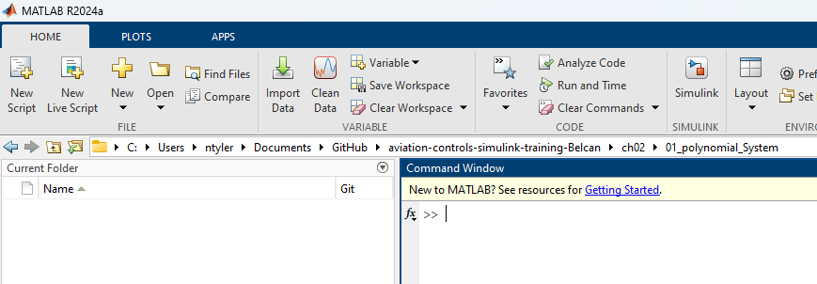
Navigate to training folder “01_polynomial_System”
How to Add To Project
Step 1. Double Click Folder
Step 2. Observe Empty Folder

Slide 19
How to Create a new Simulink Model

Slide 20
Detailed Success in this section looks like knowing how to …
How to Create a new Simulink Model
Create a new Simulink Model
  Creating File (slx) Create / Rename / Open

Slide 21
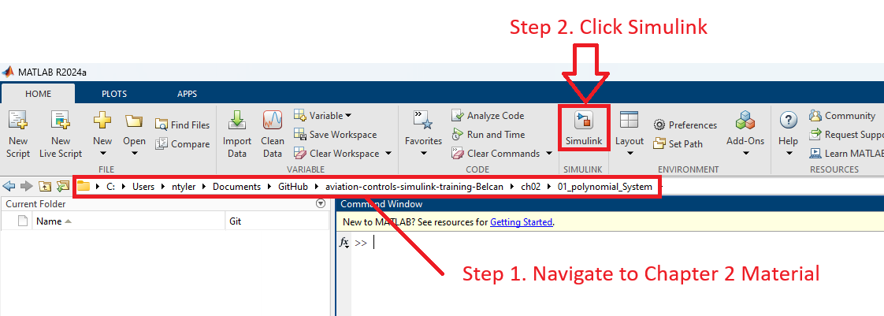
Navigate to training folder & create Simulink Model
How to Create a new Simulink Model

Slide 22
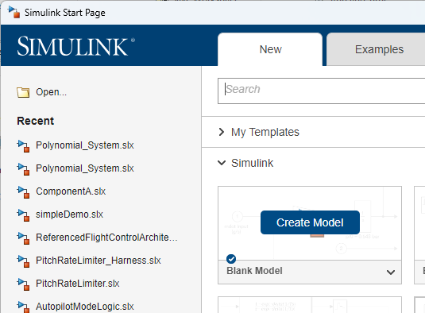
Navigate to training folder & create Simulink Model
How to Create a new Simulink Model
1) Click Create Model

Slide 23
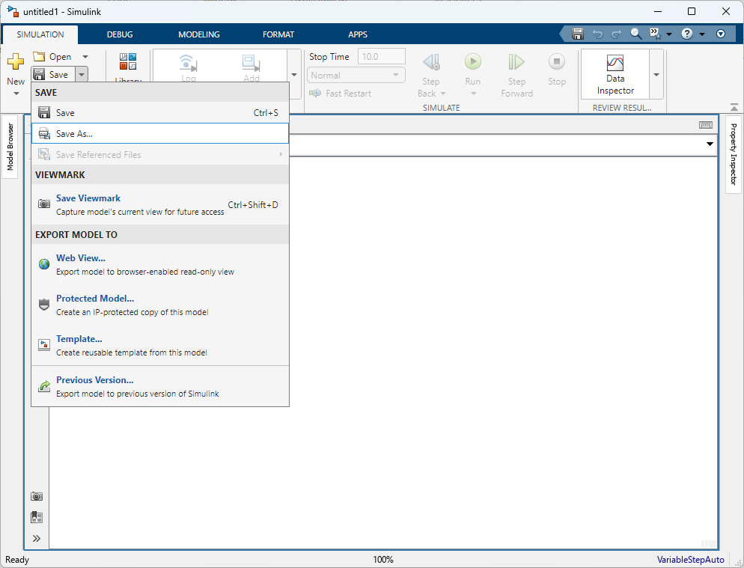
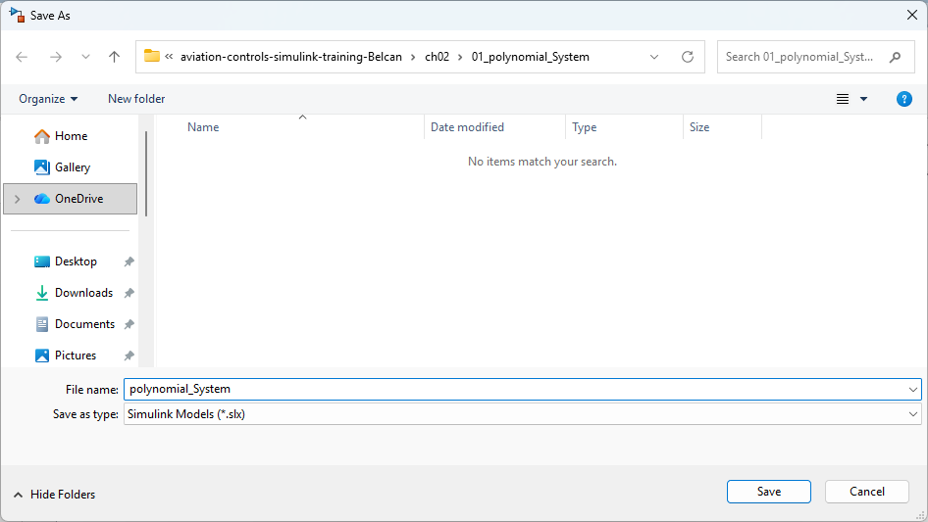
Rename Simulink File
How to Create a new Simulink Model
Step 1. Click Save
Step 2. Save As “polynomial_System”

Slide 24
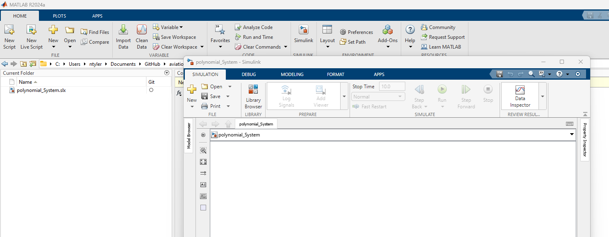
Observe File has been Renamed
How to Create a new Simulink Model

Slide 25
How to Use blocks

Slide 26
Detailed Success in this section looks like knowing how to …
How to Use blocks (Part 1)
Use blocks
  Accessing Library Browser Open / Find Blocks
  Blocks Add / Edit / Label
  Model Fit Contents to Window
  Lines Create / Edit / Format / Label / Data log

Slide 27
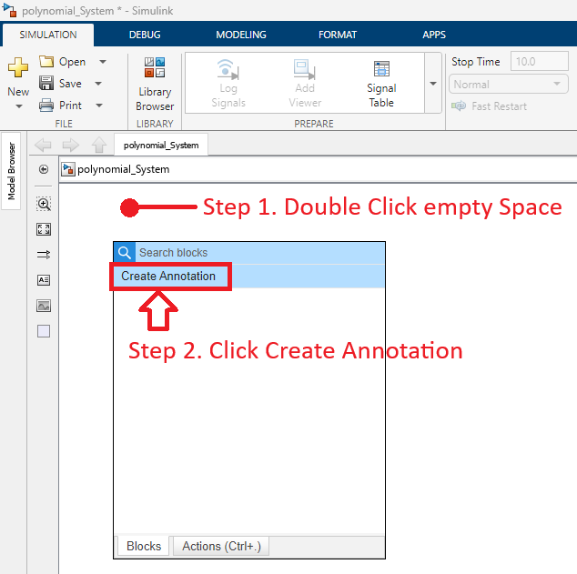
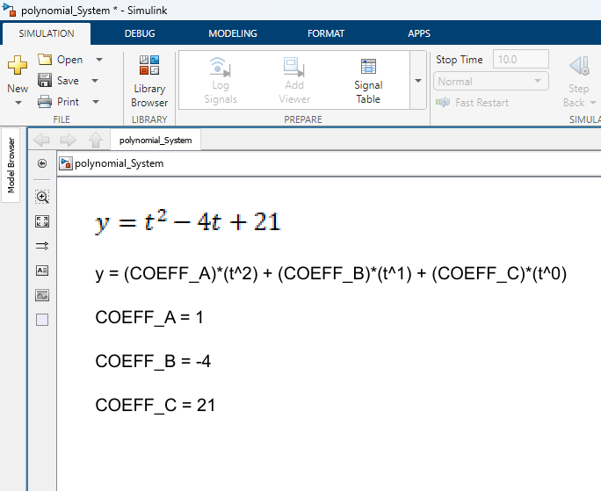
Add Blocks to Simulink Model (Method 2)
How to Use blocks (Part 1)
Step 1. Double Click on Empty Space
Step 2. Type “step” and press enter

Slide 28
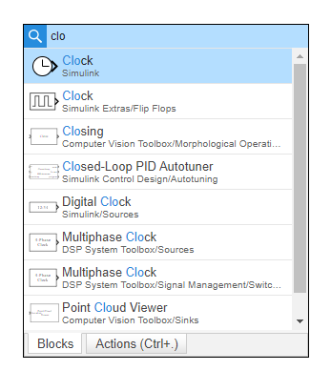
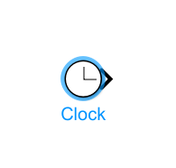
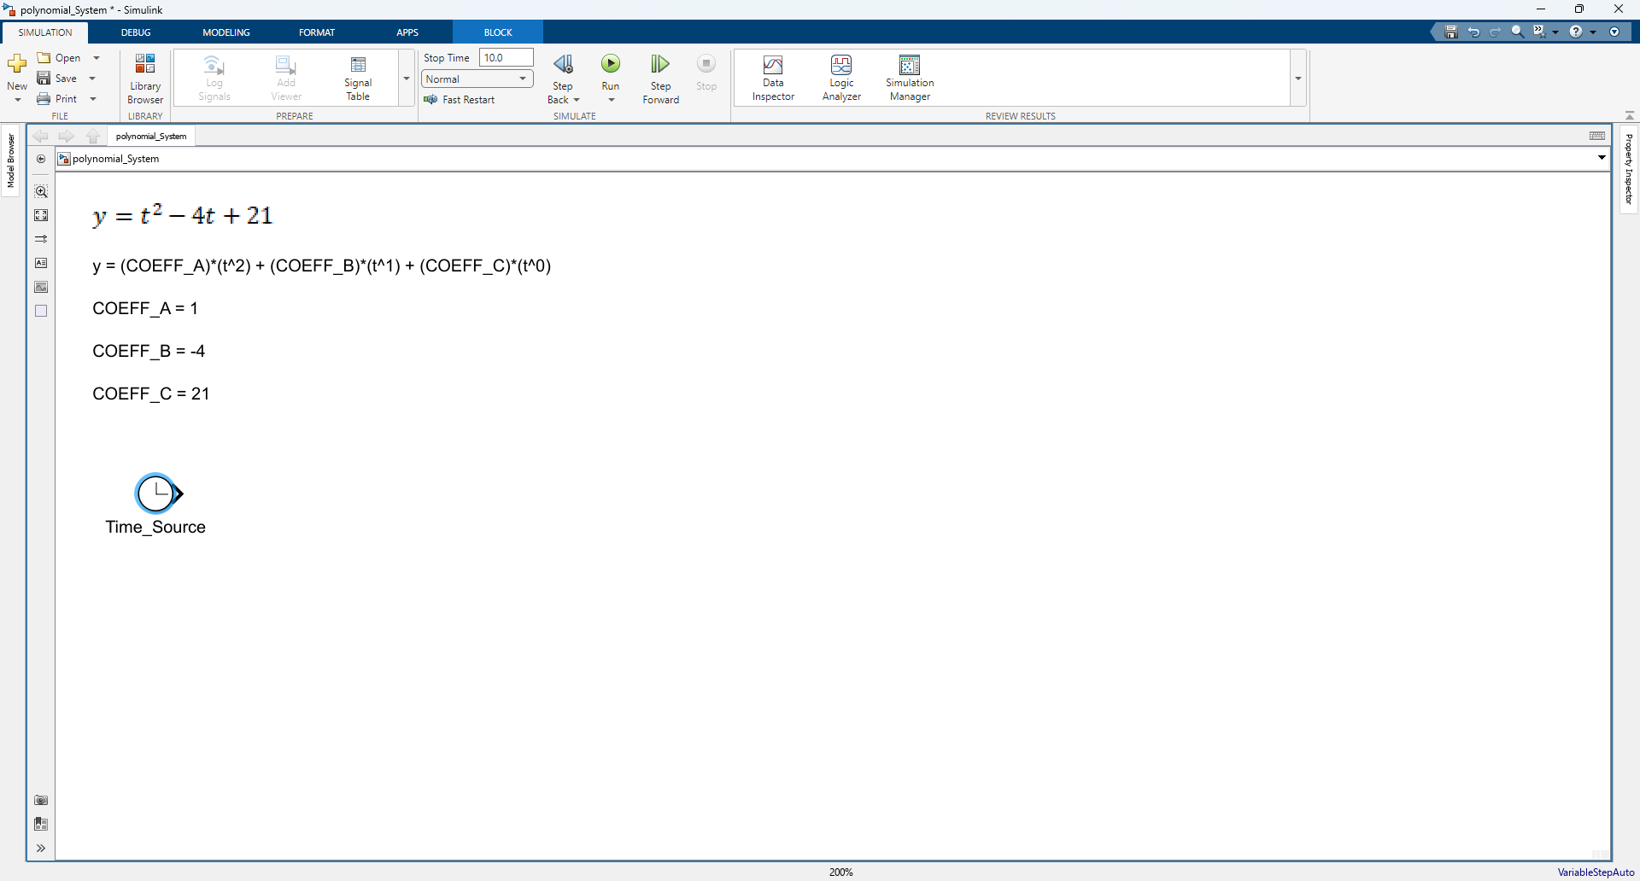
Add Clock
How to Use blocks (Part 1)
Step 1. Double Click empty space
Step 2. Add Clock
Step 3. Rename Clock
1. Type clo
2. Click
1. Click Block

Slide 29
Added Clock
How to Use blocks (Part 1)

Slide 30
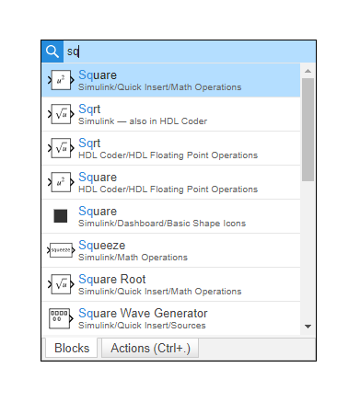
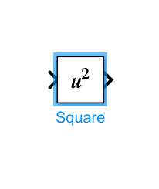
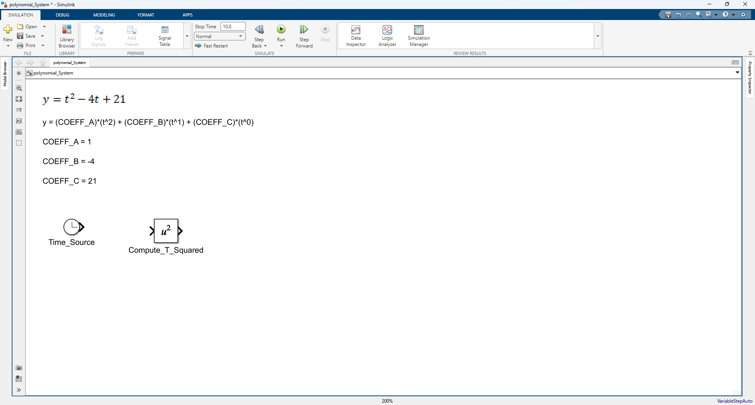
Add Square
How to Use blocks (Part 1)
Step 1. Double Click empty space
Step 2. Add Square
Step 3. Rename Square
1. Type sq
2. Click
1. Click Block

Slide 31
Added Square
How to Use blocks (Part 1)

Slide 32
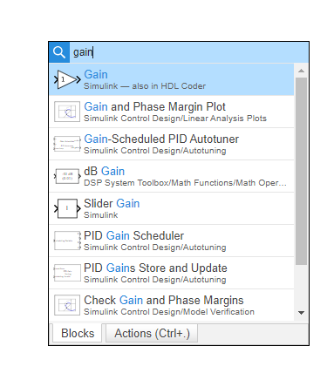
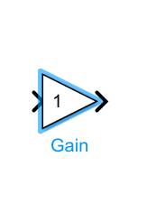
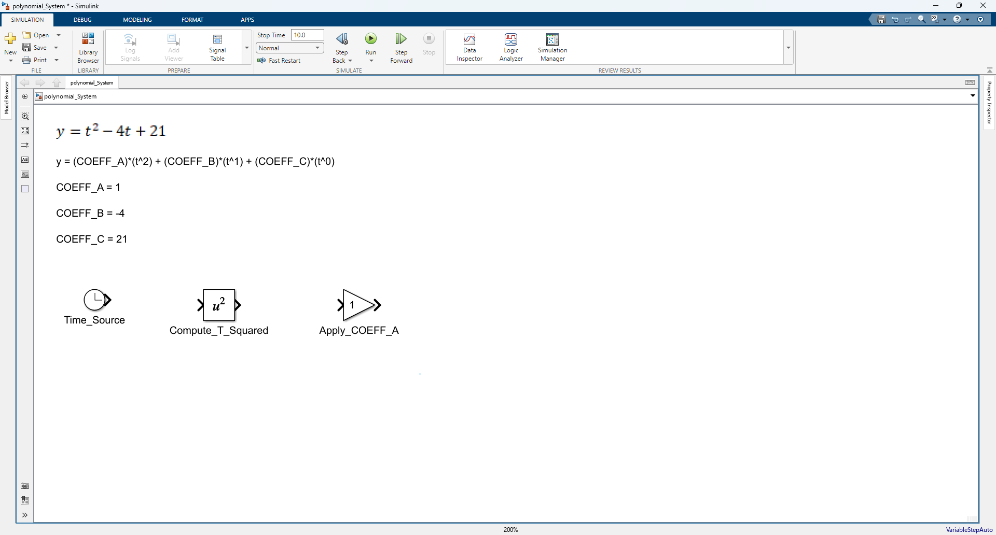
Add 1st Gain Block
How to Use blocks (Part 1)
Step 1. Double Click empty space
Step 2. Add Square
Step 3. Rename Square
1. Type gain
2. Click
1. Click Block

Slide 33
Added 1st Gain Block
How to Use blocks (Part 1)

Slide 34
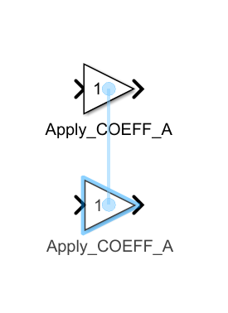
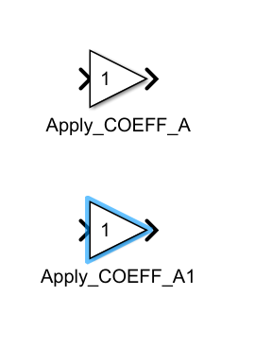
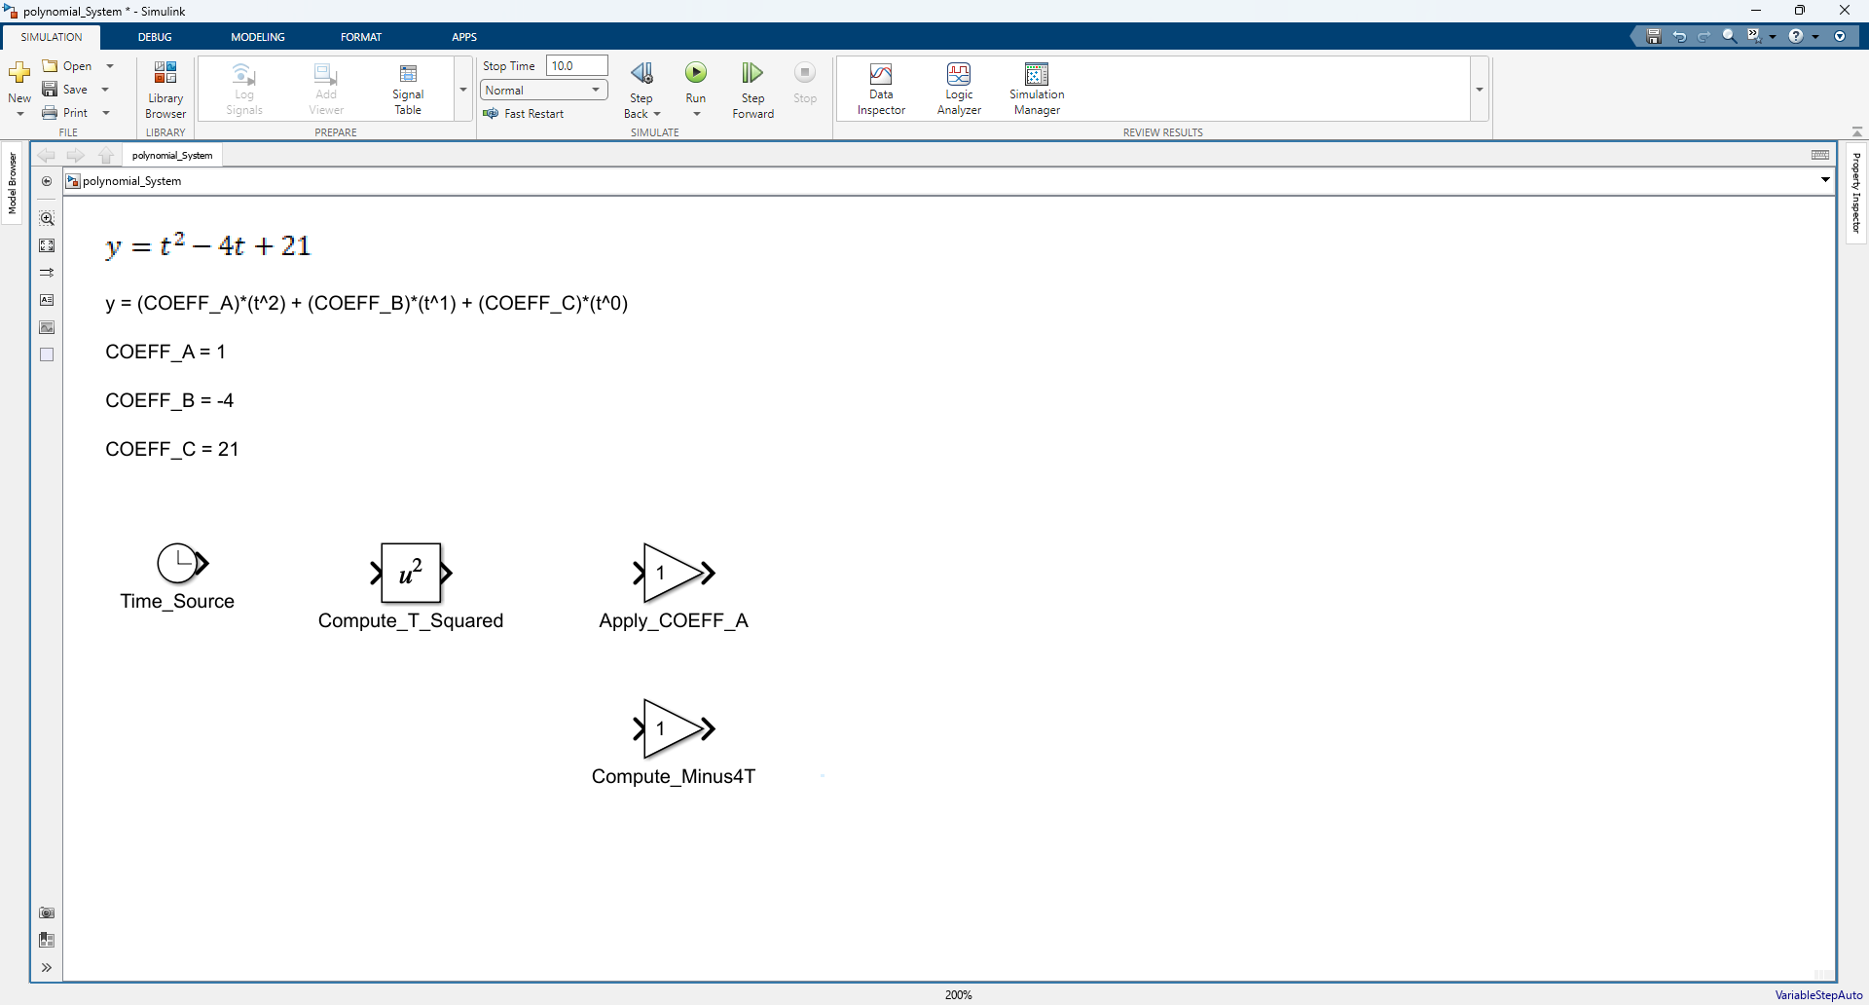
Add 2nd Gain Block
How to Use blocks (Part 1)
Step 1. Duplicate Gain block by Holding ctrl and Dragging gain block down
Step 2. Observe Duplication Result
Step 3. Rename Square
Step 1. Hold ctrl and drag gain block down
Step 1. Observe New Gain block that was generated
Step 1. Rename Gain Block

Slide 35
Added 2nd Gain Block
How to Use blocks (Part 1)

Slide 36
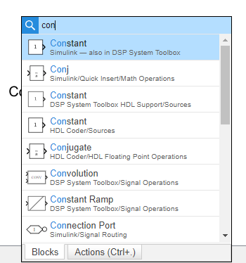
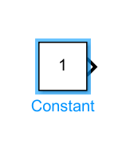
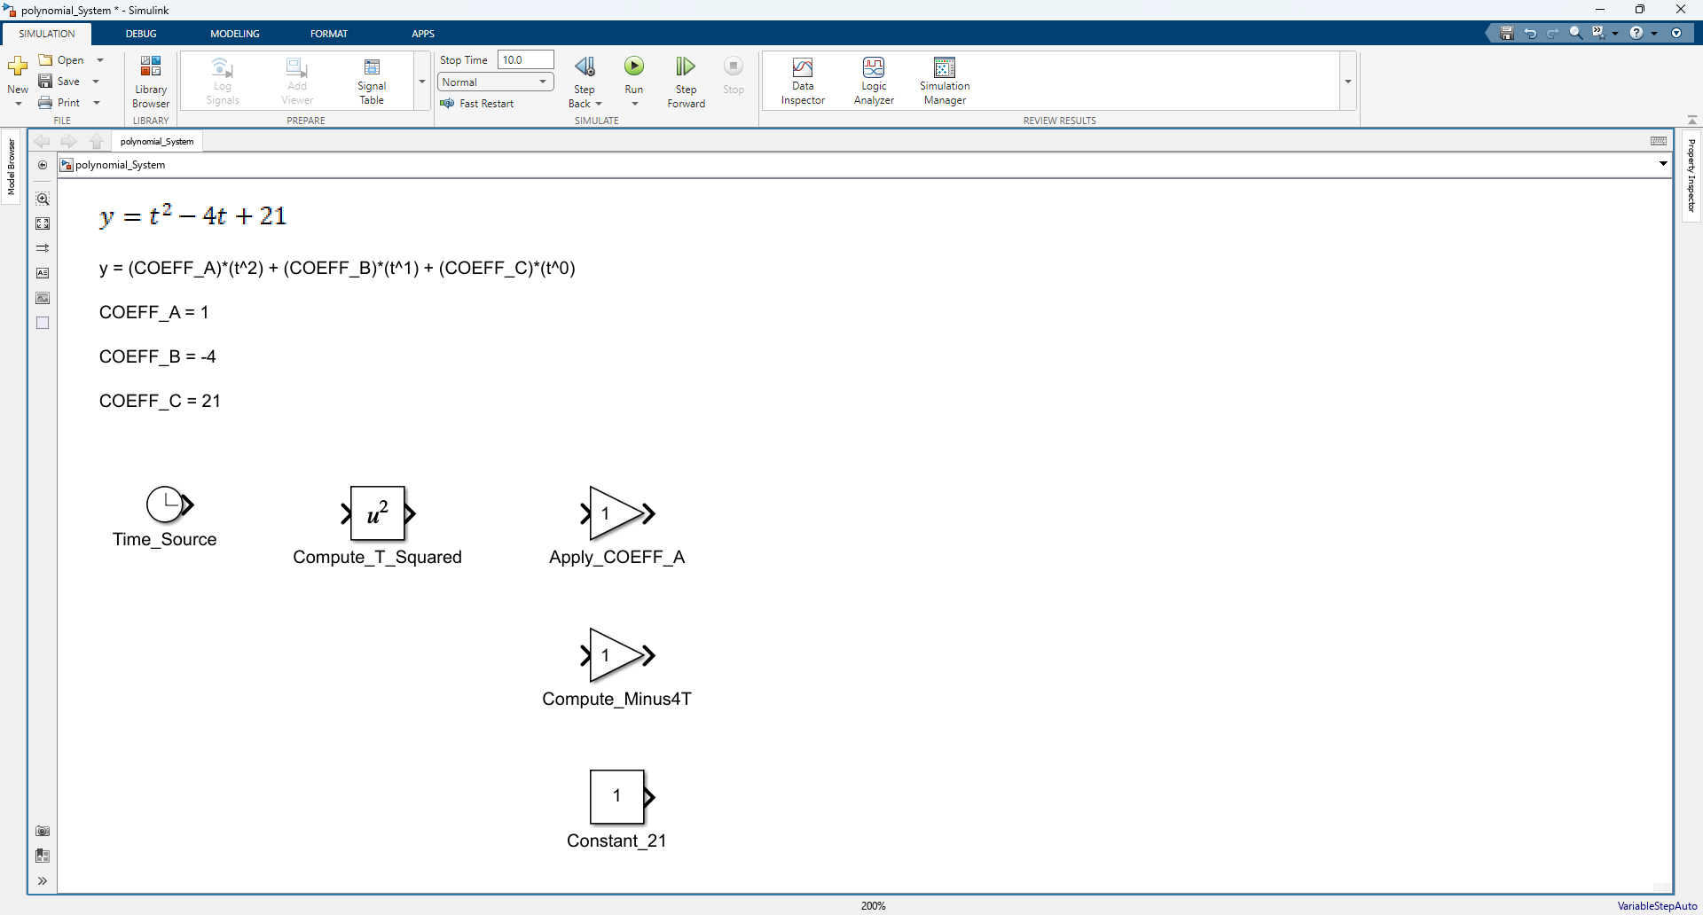
Add Constant Block
How to Use blocks (Part 1)
Step 1. Double Click empty space
Step 2. Add Constant Block
Step 3. Rename Constant Block
1. Type con
2. Click
1. Click Block

Slide 37
Added Constant Block
How to Use blocks (Part 1)

Slide 38
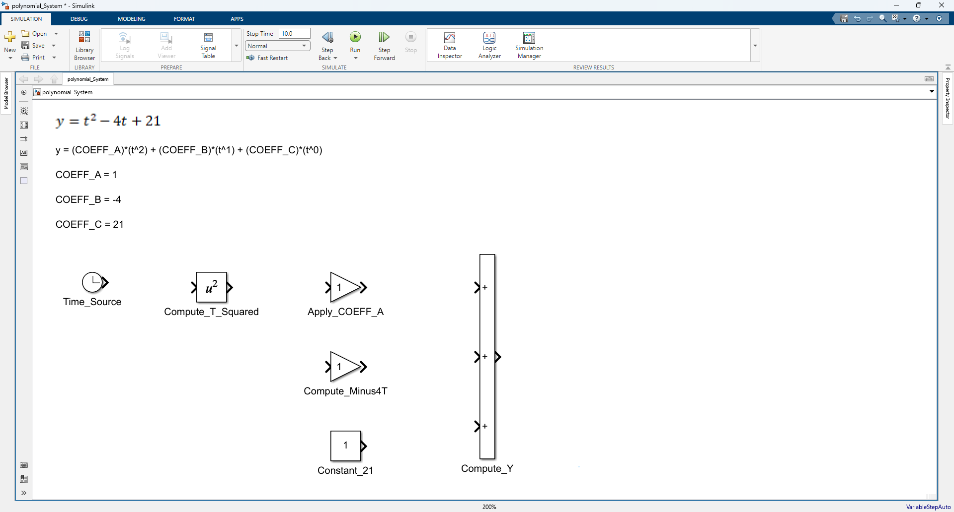
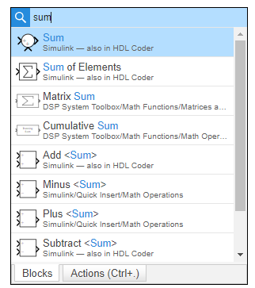
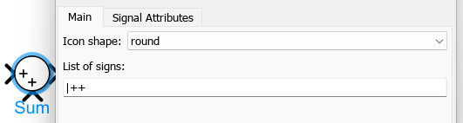
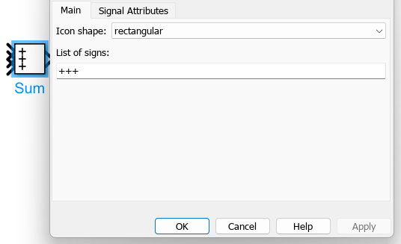
Add Sum Block
How to Use blocks (Part 1)
Step 1. Double Click empty space
Step 2. Add Sum Block & Edit Block Parameters
Step 3. Rename and resize Sum Block
1. Type sum
Step 1. Double Click Sum
2. Click
Step 2. Update Icon Shape “rectangular” & list signs “+++”
Step 3. Click Apply

Slide 39
Added Constant Block
How to Use blocks (Part 1)

Slide 40
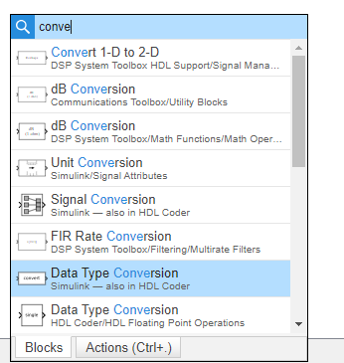
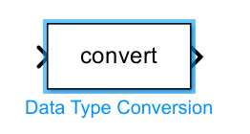
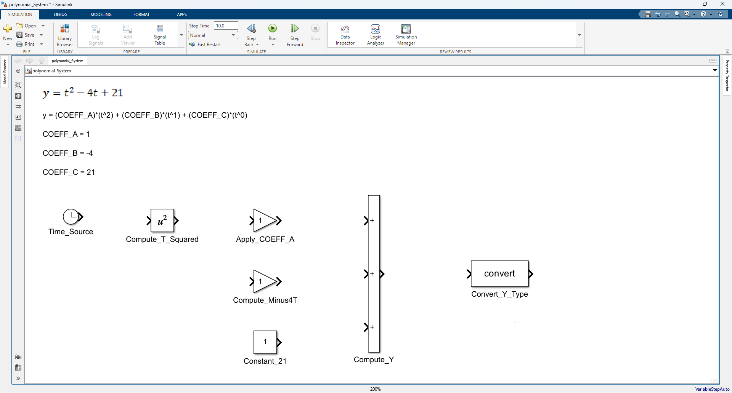
Add Data Type Conversion Block
How to Use blocks (Part 1)
Step 1. Double Click empty space
Step 2. Add Data Type Conversion
Step 3. Rename Data Type Conversion
1. Type conve
1. Click Block
2. Click

Slide 41
Added Data Type Conversion Block
How to Use blocks (Part 1)

Slide 42
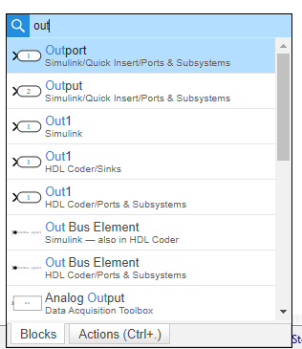
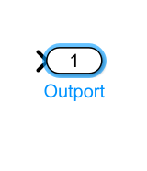
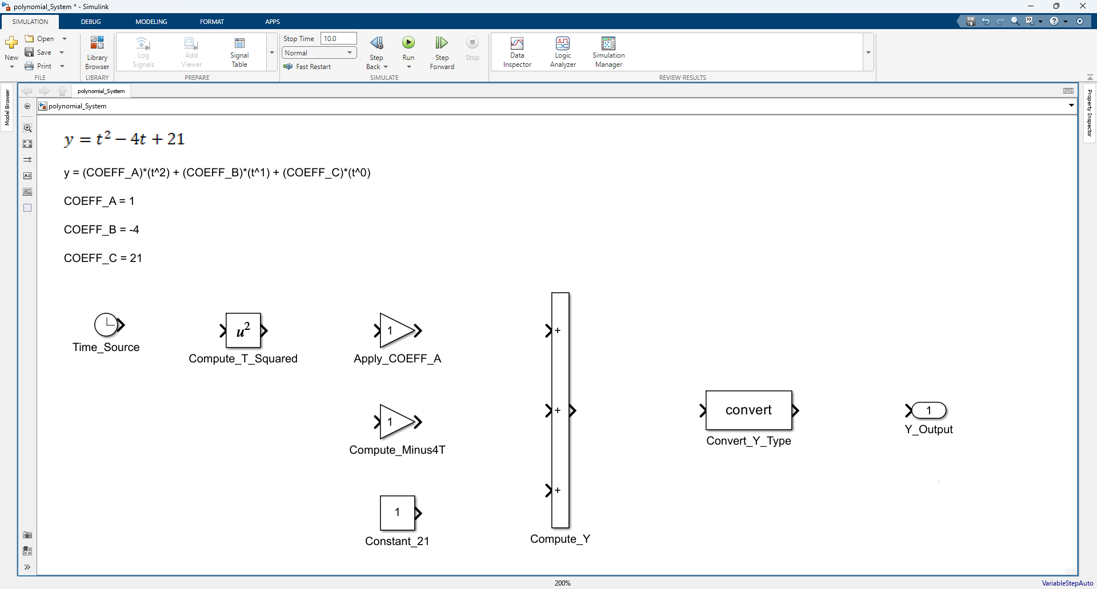
Add Outport Block
How to Use blocks (Part 1)
Step 1. Double Click empty space
Step 2. Add Outport
Step 3. Rename Outport
1. Type out
2. Click
1. Click Block

Slide 43
Added Outport Block
How to Use blocks (Part 1)

Slide 44
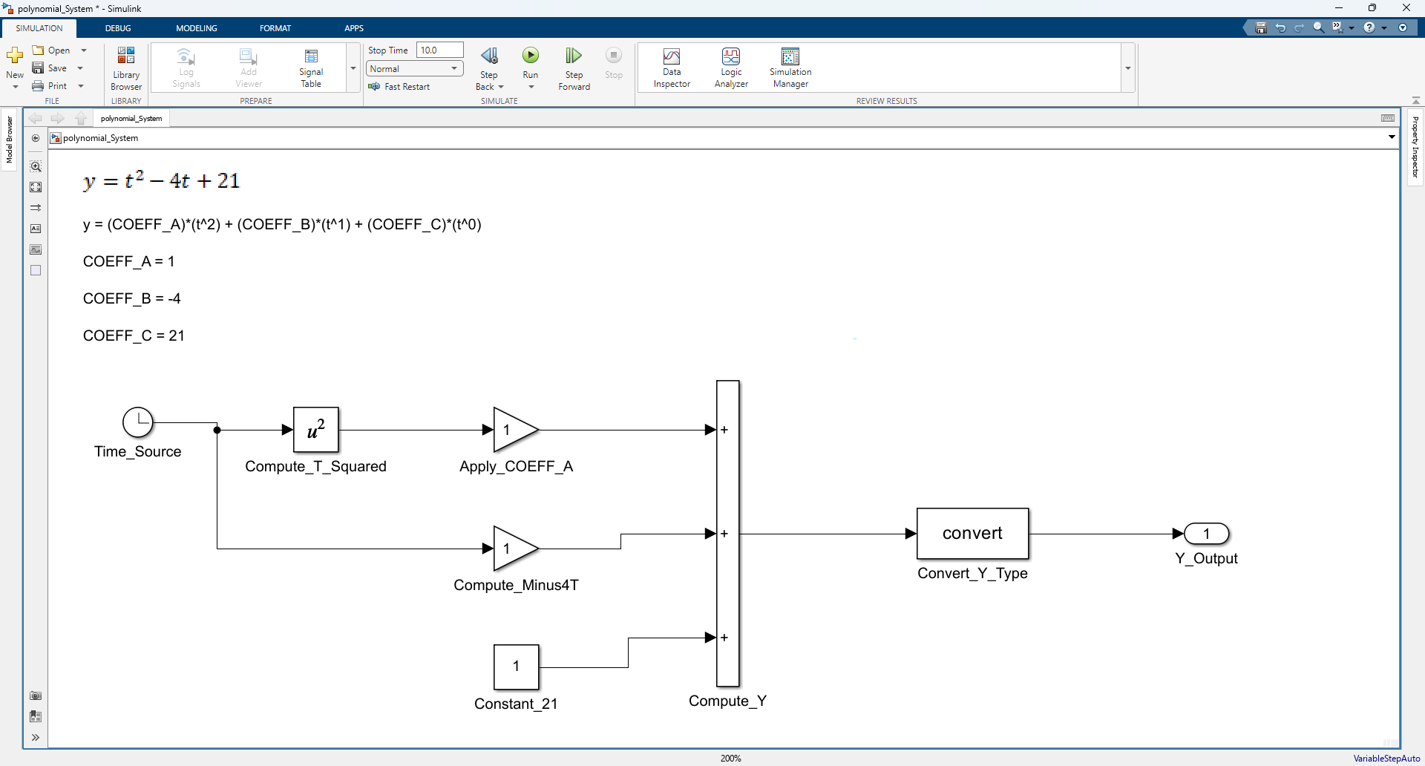
Add Signal Lines
How to Use blocks (Part 1)

Slide 45

Align Blocks
How to Use blocks (Part 1)

Slide 46


Show Property Inspector (Method 1)
Note: This is my preferred method
How to Use blocks (Part 1)
Step 1. Click Property Inspector
Step 2. Click Down Arrow and then Click Restore

Slide 47


Show Property Inspector (Method 2)
Note: This method will force property Inspector to activate
How to Use blocks (Part 1)
Step 1. Click “MODELING” Tab and expand options
Step 2. Click Property Inspector

Slide 48


Update Signal: t
How to Use blocks (Part 1)
Step 1. Select Line and Update Signal Name
Step 2. Check Boxes
Step 1. Check Boxes
Step 1. Select Line
Step 2. Observe

Slide 49


Update Signal: t_squared
How to Use blocks (Part 1)
Step 1. Select Line and Update Signal Name
Step 2. Check Boxes
Step 1. Check Boxes
Step 1. Select Line
Step 2. Observe

Slide 50


Update Parameter: COEFF_A
How to Use blocks (Part 1)
Step 1. Select Line and Update Parameter Name
Step 2. Observe renamed parameter
Step 1. Check Boxes
Step 1. Select Block
Step 2. Observe

Slide 51



Format Blocks to Same Size
Note: The last block you select is used as the formatting reference. All other selected blocks will be formatted to match it.
How to Use blocks (Part 1)
Step 1. Select Blocks
Step 2. Select Final Block
Step 3. Format Blocks
Step 1. Click Match
Step 1. Shift Hold Select Block
Step 2. Observe
Step 1. Select Blocks

Slide 52

Format Blocks to Same Size
Note: The last block you select is used as the formatting reference. All other selected blocks will be formatted to match it.
How to Use blocks (Part 1)
Step 1. Select Blocks
Step 2. Observe Aligned Blocks
Step 1. Click Align
Step 2. Shift Hold Select Block
Step 2. Observe
Step 1. Select Blocks

Slide 53


Update Parameters: COEFF_B & COEFF_C
How to Use blocks (Part 1)
Step 1. Update Gain block
Step 2. Update Constant Block

Slide 54


Update Signal: coeffA_t_squared
How to Use blocks (Part 1)
Step 1. Select Line and Update Signal Name
Step 2. Check Boxes
Step 1. Check Boxes
Step 1. Select Line
Step 2. Observe

Slide 55


Update Signal: neg_4t
How to Use blocks (Part 1)
Step 1. Select Line and Update Signal Name
Step 2. Check Boxes
Step 1. Check Boxes
Step 1. Select Line
Step 2. Observe

Slide 56


Update Signal: const_21
How to Use blocks (Part 1)
Step 1. Select Line and Update Signal Name
Step 2. Check Boxes
Step 1. Check Boxes
Step 1. Select Line
Step 2. Observe

Slide 57


Update Signal: y_raw
How to Use blocks (Part 1)
Step 1. Select Line and Update Signal Name
Step 2. Check Boxes
Step 1. Check Boxes
Step 1. Select Line
Step 2. Observe

Slide 58


Update Signal: y
How to Use blocks (Part 1)
Step 1. Select Line and Update Signal Name
Step 2. Check Boxes
Step 1. Check Boxes
Step 1. Select Line
Step 2. Observe

Slide 59


Save Model File
How to Use blocks (Part 1)
Step 1. Click Save (* indicates the file is unsaved)
Note: ctrl + s will also save the document
Step 2. Observe the Saved File

Slide 60
How to Use Model Configuration

Slide 61
Detailed Success in this section looks like knowing how to …
How to Use Model Configurations
Use blocks
  Accessing Library Browser Open / Find Blocks
  Blocks Add / Edit / Label
  Model Fit Contents to Window
  Lines Create / Edit / Format / Label / Data log

Slide 62


Update Model Configurations (Part 1)
How to Use Model Configurations
Step 1. Click Model Settings
Step 2. Observe the opened Model Configuration.

Slide 63

Update Model Configurations (Part 2)
How to Use Model Configurations
Step 1 Update Model Configuration Settings
Step 2. Observe Stop time after clicking apply
Step 1. Set Type to 15
Step 3. Set Solver to discrete
Step 1. Observe Stop Time was Updated
Step 4. Set Fixed-step size to 0.25
Step 2. Set Type to Fixed-step
Step 5. Click Apply

Slide 64
Save Model File
How to Use Model Configurations
Step 1. Click Save (* indicates the file is unsaved)
Note: ctrl + s will also save the document
Step 2. Observe the Saved File

Slide 65
How to Use Model Explorer

Slide 66
Detailed Success in this section looks like knowing how to …
How to Use Model Explorer
Use Model Explorer
  Data Dictionary (sldd) Create / Edit
  Signal Attributes View / Edit / Property Inspector

Slide 67
Open Model Explorer
How to Use Model Explorer
Step 1. Click “MODELING” Tab and Click “Model Explorer”
Step 2. Observe Model Explorer Window
Step 1. Click “MODELING” Tab
Step 2. Click “Model Explorer”

Slide 68
Create Data Dictionary File (.sldd)
Note: In later chapters I deep dive the data dictionary. For now, I will only cover high level topics.
How to Use Model Explorer
Step 1. Drill Down to “External Data” and then Click “New”
Step 1. Drill Down to “External Data”
Step 2. Click New to create a new data dictionary

Slide 69
Create Data Dictionary File (.sldd)
How to Use Model Explorer
Step 1. Save file as “polynomial_System”
Step 2) Apply Changes
Step 1. Create File polynomial_System.sldd
Step 1. Observe our created file polynomial_System.sldd
This will hold our signal definitions and more .
Step 2. Click Save
Step 2. Click Apply

Slide 70
Open Design Data
How to Use Model Explorer
Step 1. Click “polynomial_System”
Step 2. Drill down to Design Data
Step 3. Observe Design Data
Step 1. Click
Step 1. Expand
Step 2. Click

Slide 71
Add Simulink Signal
Note: Just Create the blank signal for now
How to Use Model Explorer
Step 1. Click “Simulink Signal” x6
Note: This will add a new signal to your data inspector.
Step 1. Click “Simulink Signal”
Repeat Action x6

Slide 72
Add Simulink Parameter
Note: Just Create the blank parameter for now
How to Use Model Explorer
Step 1. Click “Simulink Parameter” x3
Note: This will add a new signal to your data inspector.
Step 1. Click “Simulink Parameter”
Repeat Action x3

Slide 73
Rename Signals and Parameters
How to Use Model Explorer
Step 1. Click each row and update the Name of each signal and parameter
Note: This will add a new signal to your data inspector.
Step 1. Update Names

Slide 74
Mass Update Data Type
Note: Mandatory
How to Use Model Explorer
Step 1. Shift + Hold + select rows
Step 2. Click & Update Field
Step 3. Observe updated column
Step 1. Observe Data Type Before Update is “auto”
1. Click field
2. Select
Step 1. Observe Data Type After Update is “double”

Slide 75
Mass Update Dimensions
Note: Optional
How to Use Model Explorer
Step 1. Shift + Hold + select rows
Step 2. Click & Update Field
Step 3. Observe updated column
Step 1. Observe Dimensions Before Update is -1 or [0 0]
Step 1. Click field
Step 2. Type 1
Step 1. Observe Dimensions After Update is 1 or [1 1]

Slide 76
Mass Update Storage Class
Note: Optional
How to Use Model Explorer
Step 1. Shift + Hold + select rows
Step 2. Click & Update Field
Step 3. Observe updated column
Step 1. Observe Storage Class Before Update is auto
1. Click field
2. Select
Step 1. Observe Storage Class After Update is ExportedGlobal

Slide 77
Observe Data Dictionary After Mass Update
How to Use Model Explorer
Step 1. Observe Updated Columns
Step 1. Observe Updated Columns

Slide 78
Update Signal: y_raw
How to Use Model Explorer
Step 1. Select Signal and Update remaining fields
Step 1. Select signal
Step 2. Update Min, Max, & Description

Slide 79
Update Signal: y
How to Use Model Explorer
Step 1. Select Signal and Update remaining fields
Step 1. Select signal
Step 2. Update Min, Max, & Description

Slide 80
Update Signal: t_squared
How to Use Model Explorer
Step 1. Select Signal and Update remaining fields
Step 1. Select signal
Step 2. Update Min, Max, & Description

Slide 81
Update Signal: t
How to Use Model Explorer
Step 1. Select Signal and Update remaining fields
Step 1. Select signal
Step 2. Click & Update fields Min, Max, & Unit

Slide 82
Update Signal: neg_4t
How to Use Model Explorer
Step 1. Select Signal and Update remaining fields
Step 1. Select signal
Step 2. Click & Update fields Min & Max
Step 3. Update Description

Slide 83
Update Signal: coeffA_t_squared
How to Use Model Explorer
Step 1. Select Signal and Update remaining fields
Step 1. Select signal
Step 2. Click & Update fields Min, Max, & Unit
Step 3. Update Description

Slide 84
Update Parameter: COEFF_C
How to Use Model Explorer
Step 1. Select Signal and Update remaining fields
Step 1. Select Param
Step 2. Update Value
Step 3. Update Description

Slide 85
Update Parameter: COEFF_B
How to Use Model Explorer
Step 1. Select Signal and Update remaining fields
Step 1. Select Param
Step 2. Update Value
Step 3. Update Description

Slide 86
Update Parameter: COEFF_A
How to Use Model Explorer
Step 1. Select Signal and Update remaining fields
Step 1. Select Param
Step 2. Update Value
Step 3. Update Description

Slide 87
Save Changes made to Data Dictionary (.sldd)
Note: Changes made to the data dictionary must be saved from Model Explorer. Otherwise, the changes will not be applied and may be lost.
Note: Pressing Ctrl+S in Model Explorer does not save data dictionary changes. Instead, it may create a new signal or have a different action than expected. To save dictionary changes, right-click the data dictionary and select Save Changes. Yes, this behavior surprises everyone at least once.
How to Use Model Explorer
Step 1. Click polynomial_System*
Step 2. Right Click & Save Changes
Step 3. Observe Saved File
1. Click
1. Right Click
2. Click Save

Slide 88
Save Model File
How to Use Model Configurations
Step 1. Click Save (* indicates the file is unsaved)
Note: ctrl + s will also save the document
Step 2. Observe the Saved File

Slide 89
How to Run a simulation

Slide 90
Detailed Success in this section looks like knowing how to …
How to Run a simulation
Run a simulation
  Run Shortcut (CTRL+T)
  Stop Time Default Value is 10 sec

Slide 91
Run Simulation
How to Run a simulation
Step 1. Click Run or press CTRL+T
1. Click Tab “SIMULATION”
2. Click Run or press CTRL+T

Slide 92
How to Use Data inspector

Slide 93
Detailed Success in this section looks like knowing how to …
How to Use Data inspector
Use Data inspector
  Graph Graph Data / Edit Grid / Use Cursors
  Stop Time Value is 15 sec

Slide 94
Open Data Inspector
Note: Simulation must be run prior to opening Data inspector to observe raw values.
How to Use Data inspector
Step 1. Click Data Inspector
1. Click Tab “SIMULATION”
2. Click Data Inspector

Slide 95
Setup Data Inspector
How to Use Data inspector

Slide 96
Add Cursor
How to Use Data inspector

Slide 97
Save Data Inspector File
How to Use Data inspector
Click Save Icon
Click Save / Save As
Save File

Slide 98
How to Use blocks (Part 2)

Slide 99
Detailed Success in this section looks like knowing how to …
How to Use blocks (Part 2)
Use blocks
  Blocks Format
  Signal Attributes View / Edit / Property Inspector

Slide 100
Formatting Blocks – Align Left
Note: both lines and blocks may be selected for this section
Note: align commands will only affect the placement of the blocks
How to Use blocks (Part 2)
Step 1. Select blocks & then click “Format” tab
Step 2. Click Align Right
Step 3. Observe the blocks have been aligned

Slide 101
Show Property Inspector (Method 1)
Note: This method will force property Inspector to activate
How to Use blocks (Part 2)
Step 1. Click “MODELING” Tab and expand options
Step 2. Click Property Inspector

Slide 102
Show Property Inspector (Method 2)
Note: This is my preferred method
How to Use blocks (Part 2)
Step 1. Click Property Inspector
Step 2. Click Down Arrow and then Click Restore

Slide 103
Update Signal Attributes (P1)
How to Use blocks (Part 2)
Step 1. Click Block + Expand & Edit Signal Attributes
Step 2. Observe updated Attributes

Slide 104
Update Signal Attributes (P1)
How to Use blocks (Part 2)
Step 1. Click Block + Expand & Edit Signal Attributes
Step 2. Observe updated Attributes

Slide 105
Save Changes
Note: The star * was removed after the save took place
How to Use blocks (Part 2)
Step 1. Click Save
Step 2. Observe document has been saved.

Slide 106
How to Use Requirements editor

Slide 107
Detailed Success in this section looks like knowing how to …
How to Use Requirements Editor
Use Requirements Editor
  Use Requirements editor(slreqx) Create / View / Edit / Link
  Use Requirements Manager Create / View / Edit / Link

Slide 108
Open Requirements Editor
How to Use Requirements Editor
Step 1. Click “APPS” tab and click down arrow
Step 2. Click “Requirements Editor”
Step 3. Observe “Requirements Editor” was opened.

Slide 109
Create High Level Requirements (HLR) File (.slreqx)
How to Use Requirements Editor
Step 1. Click New Requirement Set
Step 2. Enter file Name “sampleHLR” and click “Save”
Step 3. Observe newly added requirements File.

Slide 110
Add New Requirement Parent Requirement
How to Use Requirements Editor
Step 1. Right Click and Add Requirement.
Step 2. Observe Newly added Requirement

Slide 111
Update Requirement (Part 1)
How to Use Requirements Editor
Step 1. Click Requirement
Step 2. Update Properties

Slide 112
Update Requirement (Part 2)
How to Use Requirements Editor
Step 1. Click Requirement
Step 2. Observe Updated Properties

Slide 113
Add New Requirement Parent Requirement
How to Use Requirements Editor
Step 1. Right Click and Add Requirement.
Step 2. Observe Newly added Requirement

Slide 114
Edit Child Requirement (Part 1)
How to Use Requirements Editor
Step 1. Click Child Requirement
Step 2. Observe Updated Properties

Slide 115
Edit Child Requirement (Part 2)
How to Use Requirements Editor
Step 1. Click Child Requirement
Step 2. Observe Updated Properties

Slide 116
Link Child Requirement To Block (Part 1A)
How to Use Requirements Editor
Step 1. Ensure “Functional C” is selected
Step 2. Click Block “prodBlkC” and Click Link to Selection in Requirements Browser

Slide 117
Link Child Requirement To Block (Part 2A)
How to Use Requirements Editor
Step 1. Observe Block has been linked to Child Requirement

Slide 118
Link Child Requirement To Block (Part 1B)
How to Use Requirements Editor
Step 1. Ensure “Functional C” is selected
Step 2. Select Blocks “constBlkA” & “constBlkB” & Click “Link to Selection in Requirements Browser”

Slide 119
Link Child Requirement To Block (Part 2B)
How to Use Requirements Editor
Step 1. Observe Block has been linked to Child Requirement

Slide 120
Save Changes
Note: The star * was removed after the save took place
How to Use Requirements Editor
Step 1. Click Save
Step 2. Observe document has been saved.

Slide 121

Open Requirements Manager
How to Use Requirements Manager
Step 1. Click “APPS” tab and click down arrow
Step 2. Click “Requirements Manager”

Slide 122

Observe “Requirements Manager” panels were opened
How to Use Requirements Manager

Slide 123
▶ Launch Quiz

Slide 124


Relaunch the add-in
Microsoft Power BI
After you install the add-in, you can launch it by choosing the add-in button on the Home tab
On the Home tab
Home
Add-ins
Need more help?
Return to your internet browser or copy this link into your browser:
https://pages.store.office.com/addinsinstallpage.aspx?rs=en-US&assetid=WA200003233&isWac=True&ui=en-US&ad=US

Slide 125
Admin Only Links
Only the Admin uses these links
Quiz – Summary Page (METRICS for Mike and Brandon)
Quiz – Responses Overview
Quiz – Excel Log
My files – OneDrive (Where Excel Log is stored)
Power BI – Workspace
Power BI – Results

